Slide 1
Electromagnetic Signal
Can be expressed as aunction of time
As well as as a function of frequency
  Signal consists of components of different frequencies reffered to as composite waves

Slide 2
Time-Domain Concepts
Analog signal - signal intensity varies in a smooth fashion over time
  No breaks or discontinuities in the signal
Digital signal - signal intensity maintains a constant level for some period of time and then changes to another constant level
Periodic signal - analog or digital signal pattern that repeats over time
  s(t +T ) = s(t ) -¥< t < +¥
    where T is the period of the signal

Slide 3
Time-Domain Concepts
Aperiodic signal - analog or digital signal pattern that doesn't repeat over time
Peak amplitude (A) - maximum value or strength of the signal over time; typically measured in volts
Frequency (f )
  Rate, in cycles per second, or Hertz (Hz) at which the signal repeats

Slide 4
Time-Domain Concepts
Period (T ) - amount of time it takes for one repetition of the signal
  T = 1/f
Phase (φ) - measure of the relative position in time within a single period of a signal
Wavelength (λ) - distance occupied by a single cycle of the signal
  Or, the distance between two points of corresponding phase of two consecutive cycles

Slide 5
Sine Wave Parameters
General sine wave
  s(t ) = A sin(2πft + φ)
Figure 2.3 shows the effect of varying each of the three parameters
  (a) A = 1, f = 1 Hz, φ = 0; thus T = 1s
  (b) Reduced peak amplitude; A=0.5
  (c) Increased frequency; f = 2, thus T = ½
  (d) Phase shift; φ = π/4 radians (45 degrees)
note: 2π radians = 360° = 1 period

Slide 6
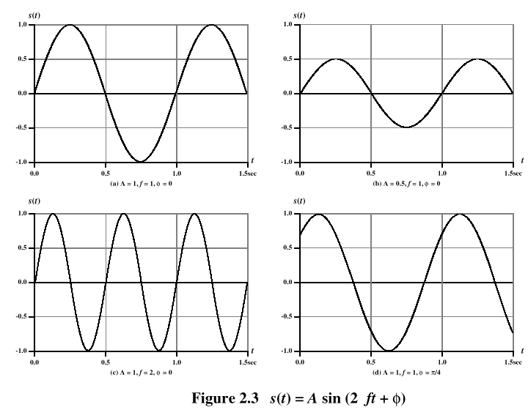
Sine Wave Parameters

Slide 7
Time vs. Distance
When the horizontal axis is time, as in Figure 2.3, graphs display the value of a signal at a given point in space as a function of time
With the horizontal axis in space, graphs display the value of a signal at a given point in time as a function of distance
  At a particular instant of time, the intensity of the signal varies as a function of distance from the source

Slide 8
Frequency-Domain Concepts
Fundamental frequency - when all frequency components of a signal are integer multiples of one frequency, it’s referred to as the fundamental frequency
Spectrum - range of frequencies that a signal contains
Absolute bandwidth - width of the spectrum of a signal
Effective bandwidth (or just bandwidth) - narrow band of frequencies that most of the signal’s energy is contained in

Slide 9
Frequency-Domain Concepts
Any electromagnetic signal can be shown to consist of a collection of periodic analog signals (sine waves) at different amplitudes, frequencies, and phases
The period of the total signal is equal to the period of the fundamental frequency

Slide 10
Relationship between Data Rate and Bandwidth
The greater the bandwidth, the higher the information-carrying capacity
therefore
  Any digital waveform will have infinite bandwidth
  BUT the transmission system will limit the bandwidth that can be transmitted
  AND, for any given medium, the greater the bandwidth transmitted, the greater the cost
  HOWEVER, limiting the bandwidth creates distortions

Slide 11
Data Communication Terms
Data - entities that convey meaning, or information
Signals - electric or electromagnetic representations of data
Transmission - communication of data by the propagation and processing of signals

Slide 12
Examples of Analog and Digital Data
Analog
  Video
  Audio
Digital
  Text
  Integers

Slide 13
Analog Signals
A continuously varying electromagnetic wave that may be propagated over a variety of media, depending on frequency
Examples of media:
  Copper wire media (twisted pair and coaxial cable)
  Fiber optic cable
  Atmosphere or space propagation
Analog signals can propagate analog and digital data

Slide 14
Digital Signals
A sequence of voltage pulses that may be transmitted over a copper wire medium
Generally cheaper than analog signaling
Less susceptible to noise interference
Suffer more from attenuation
Digital signals can propagate analog and digital data

Slide 15
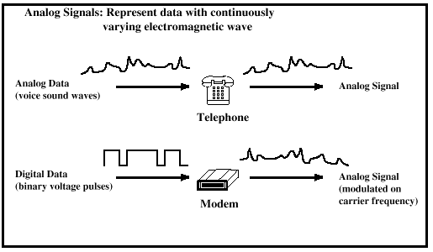
Analog Signaling

Slide 16
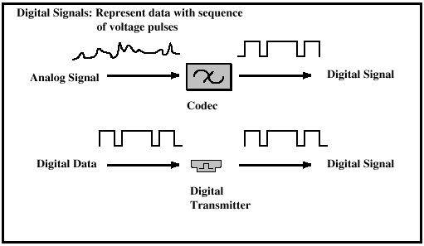
Digital Signaling

Slide 17
Reasons for Choosing Data and Signal Combinations
Digital data, digital signal
  Equipment for encoding is less expensive than digital-to-analog equipment
Analog data, digital signal
  Conversion permits use of modern digital transmission and switching equipment
Digital data, analog signal
  Some transmission media will only propagate analog signals
  Examples include optical fiber and satellite
Analog data, analog signal
  Analog data easily converted to analog signal

Slide 18
Analog Transmission
Transmit analog signals without regard to content
Attenuation limits length of transmission link
Cascaded amplifiers boost signal’s energy for longer distances but cause distortion
  Analog data can tolerate distortion
  Introduces errors in digital data

Slide 19
Digital Transmission
Concerned with the content of the signal
Attenuation endangers integrity of data
Digital Signal
  Repeaters achieve greater distance
  Repeaters recover the signal and retransmit
Analog signal carrying digital data
  Retransmission device recovers the digital data from analog signal
  Generates new, clean analog signal

Slide 20
About Channel Capacity
Impairments, such as noise, limit data rate that can be achieved
For digital data, to what extent do impairments limit data rate?
Channel Capacity – the maximum rate at which data can be transmitted over a given communication path, or channel, under given conditions

Slide 21
Concepts Related to Channel Capacity
Data rate - rate at which data can be communicated (bps)
Bandwidth - the bandwidth of the transmitted signal as constrained by the transmitter and the nature of the transmission medium (Hertz)
Noise - average level of noise over the communications path
Error rate - rate at which errors occur
  Error = transmit 1 and receive 0; transmit 0 and receive 1

Slide 22
Nyquist Bandwidth
For binary signals (two voltage levels)
  C = 2B
With multilevel signaling
  C = 2B log₂ M
    M = number of discrete signal or voltage levels

Slide 23
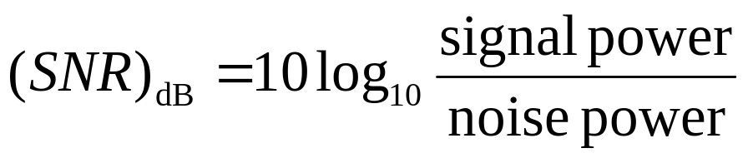
Signal-to-Noise Ratio
Ratio of the power in a signal to the power contained in the noise that’s present at a particular point in the transmission
Typically measured at a receiver
Signal-to-noise ratio (SNR, or S/N)
A high SNR means a high-quality signal, low number of required intermediate repeaters
SNR sets upper bound on achievable data rate

Slide 24
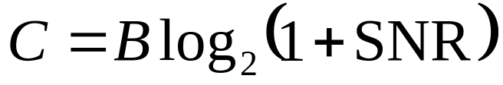
Shannon Capacity Formula
Equation:
Represents theoretical maximum that can be achieved
In practice, only much lower rates achieved
  Formula assumes white noise (thermal noise)
  Impulse noise is not accounted for
  Attenuation distortion or delay distortion not accounted for

Slide 25
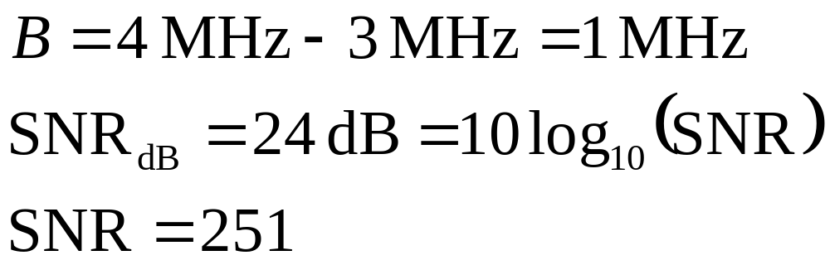
Example of Nyquist and Shannon Formulations
Spectrum of a channel between 3 MHz and 4 MHz ; SNR_{dB} = 24 dB
Using Shannon’s formula

Slide 26
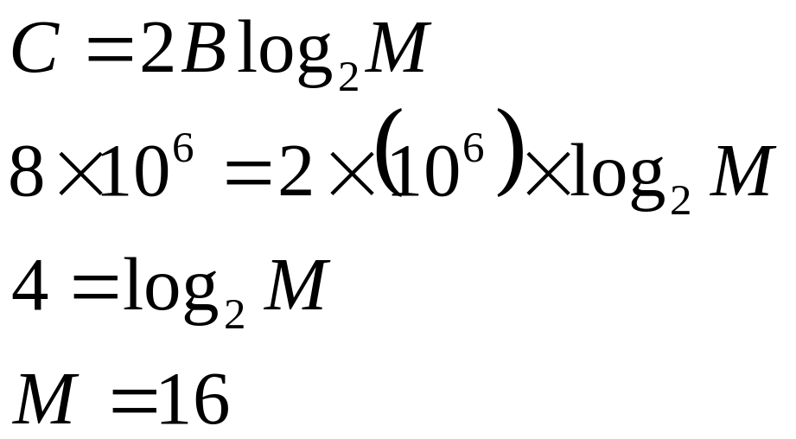
Example of Nyquist and Shannon Formulations
How many signaling levels are required?

Slide 27
Classifications of Transmission Media
Transmission Medium
  Physical path between transmitter and receiver
Guided Media
  Waves are guided along a solid medium
  E.g., copper twisted pair, copper coaxial cable, optical fiber
Unguided Media
  Provides means of transmission but does not guide electromagnetic signals
  Usually referred to as wireless transmission
  E.g., atmosphere, outer space

Slide 28
Unguided Media
Transmission and reception are achieved by means of an antenna
Configurations for wireless transmission
  Directional
  Omnidirectional

Slide 29
General Frequency Ranges
Microwave frequency range
  1 GHz to 40 GHz
  Directional beams possible
  Suitable for point-to-point transmission
  Used for satellite communications
Radio frequency range
  30 MHz to 1 GHz
  Suitable for omnidirectional applications
Infrared frequency range
  Roughly, 3x10¹¹ to 2x10¹⁴ Hz
  Useful in local point-to-point multipoint applications within confined areas

Slide 30
Terrestrial Microwave
Description of common microwave antenna
  Parabolic "dish", 3 m in diameter
  Fixed rigidly and focuses a narrow beam
  Achieves line-of-sight transmission to receiving antenna
  Located at substantial heights above ground level
Applications
  Long haul telecommunications service
  Short point-to-point links between buildings

Slide 31
Satellite Microwave
Description of communication satellite
  Microwave relay station
  Used to link two or more ground-based microwave transmitter/receivers
  Receives transmissions on one frequency band (uplink), amplifies or repeats the signal, and transmits it on another frequency (downlink)
Applications
  Television distribution
  Long-distance telephone transmission
  Private business networks

Slide 32
Broadcast Radio
Description of broadcast radio antennas
  Omnidirectional
  Antennas not required to be dish-shaped
  Antennas need not be rigidly mounted to a precise alignment
Applications
  Broadcast radio
    VHF and part of the UHF band; 30 MHZ to 1GHz
    Covers FM radio and UHF and VHF television

Slide 33
Multiplexing
Capacity of transmission medium usually exceeds capacity required for transmission of a single signal
Multiplexing - carrying multiple signals on a single medium
  More efficient use of transmission medium

Slide 34
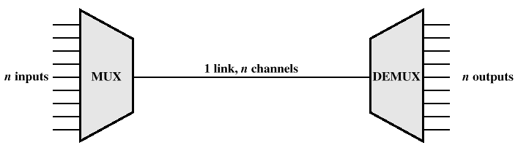
Multiplexing

Slide 35
Reasons for Widespread Use of Multiplexing
Cost per kbps of transmission facility declines with an increase in the data rate
Cost of transmission and receiving equipment declines with increased data rate
Most individual data communicating devices require relatively modest data rate support

Slide 36
Multiplexing Techniques
Frequency-division multiplexing (FDM)
  Takes advantage of the fact that the useful bandwidth of the medium exceeds the required bandwidth of a given signal
Time-division multiplexing (TDM)
  Takes advantage of the fact that the achievable bit rate of the medium exceeds the required data rate of a digital signal

Slide 37
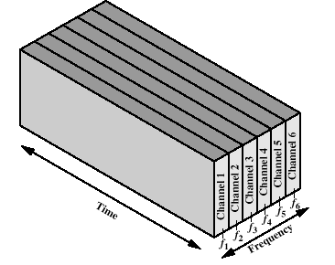
Frequency-division Multiplexing

Slide 38
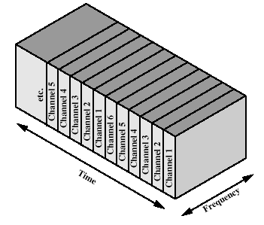
Time-division Multiplexing

Slide 39
BCT 2305 Data Communications
Multiplexing

Slide 40
Multiplexing
It was impossible to get a conversation going, everybody was talking too much.
Yogi Berra
Notes:
This quote from the start of Stallings DCC8e Ch8 points to the issue of multiple simultaneous users on a communications link.

Slide 41
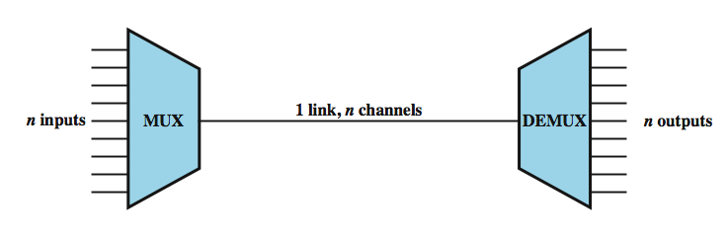
Multiplexing
multiple links on 1 physical line
common on long-haul, high capacity, links
have FDM, TDM, STDM alternatives
Notes:
To make efficient use of high-speed telecommunications lines, some form of multiplexing is used. Multiplexing allows several transmission sources to share a larger transmission capacity. A common application of multiplexing is in long-haul communications. Trunks on long-haul networks are high-capacity fiber, coaxial, or microwave links. These links can carry large numbers of voice and data transmissions simultaneously using multiplexing. Common forms of multiplexing are frequency division multiplexing (FDM), time division multiplexing (TDM), and statistical TDM (STDM).
Stallings DCC8e Figure 8.1 depicts the multiplexing function in its simplest form. There are n inputs to a multiplexer. The multiplexer is connected by a single data link to a demultiplexer. The link is able to carry n separate channels of data. The multiplexer combines (multiplexes) data from the n input lines and transmits over a higher-capacity data link. The demultiplexer accepts the multiplexed data stream, separates (demultiplexes) the data according to channel, and delivers data to the appropriate output lines.

Slide 42
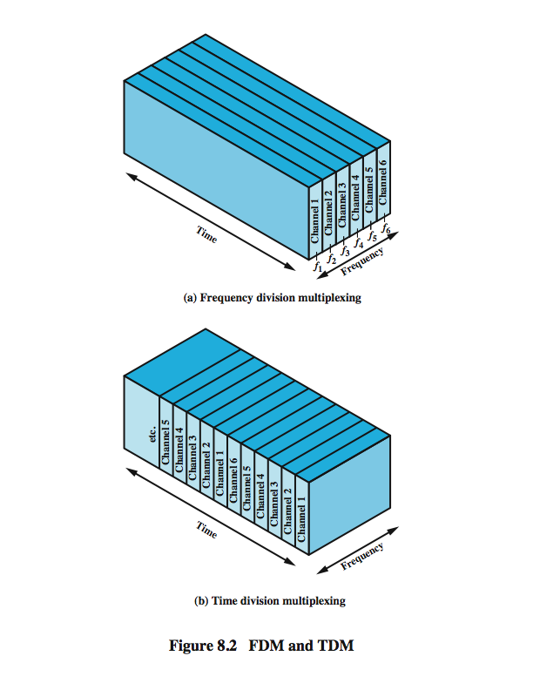
Frequency Division Multiplexing
Notes:
Frequency division multiplexing can be used with analog signals. A number of signals are carried simultaneously on the same medium by allocating to each signal a different frequency band. FDM is possible when the useful bandwidth of the transmission medium exceeds the required bandwidth of signals to be transmitted. A number of signals can be carried simultaneously if each signal is modulated onto a different carrier frequency and the carrier frequencies are sufficiently separated that the bandwidths of the signals do not significantly overlap. A general case of FDM is shown in Stallings DCC8e Figure 8.2a. Six signal sources are fed into a multiplexer, which modulates each signal onto a different frequency (f₁, …, f₆). Each modulated signal requires a certain bandwidth centered on its carrier frequency, referred to as a channel. To prevent interference, the channels are separated by guard bands, which are unused portions of the spectrum. The composite signal transmitted across the medium is analog. Note, however, that the input signals may be either digital or analog. In the case of digital input, the input signals must be passed through modems to be converted to analog. In either case, each input analog signal must then be modulated to move it to the appropriate frequency band.

Slide 43
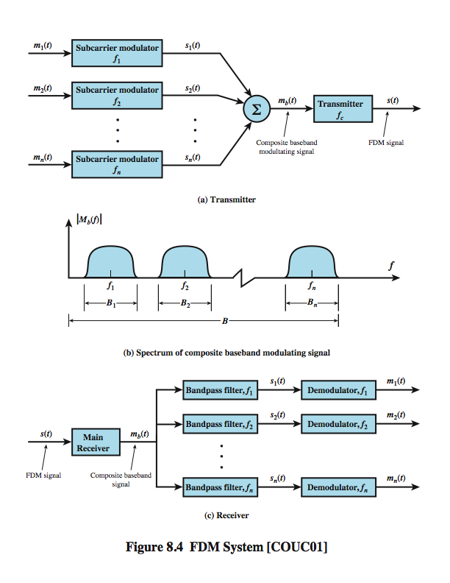
FDM
System Overview
Notes:
A generic depiction of an FDM system is shown in Stallings DCC8e Figure 8.4. A number of analog or digital signals [m_{i}(t), i = 1, n] are to be multiplexed onto the same transmission medium. Modulation equipment is needed to move each signal to the required frequency band, and multiplexing equipment is needed to combine the modulated signals. Each signal m_{i}(t) is modulated onto a carrier f_{i}; because multiple carriers are to be used, each is referred to as a subcarrier. Any type of modulation may be used. The resulting analog, modulated signals are then summed to produce a composite baseband signal m_{b}(t). Figure 8.4b shows the result. The spectrum of signal m_{i}(t) is shifted to be centered on f_{i}. For this scheme to work, f_{i} must be chosen so that the bandwidths of the various signals do not significantly overlap. Otherwise, it will be impossible to recover the original signals. The composite signal may then be shifted as a whole to another carrier frequency by an additional modulation step. The FDM signal s(t) has a total bandwidth B = Sum B_{i} . This analog signal may be transmitted over a suitable medium. At the receiving end, the FDM signal is demodulated to retrieve m_{b}(t), which is then passed through n bandpass filters, each filter centered on f_{i} and having a bandwidth B_{i}, for 1 ≤ i ≤ n. In this way, the signal is again split into its component parts. Each component is then demodulated to recover the original signal.

Slide 44
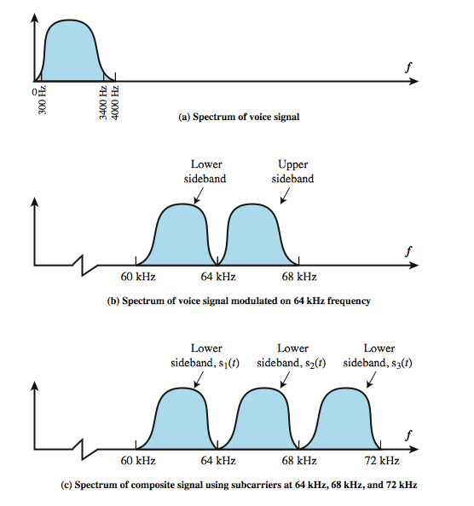
FDM Voiceband Example
Notes:
Stallings DCC8e Example 8.2 illustrates a simple example of transmitting three voice signals simultaneously over a medium. As was mentioned, the bandwidth of a voice signal is generally taken to be 4 kHz, with an effective spectrum of 300 to 3400 Hz (Figure 8.5a). If such a signal is used to amplitude-modulate a 64-kHz carrier, the spectrum of Figure 8.5b results. The modulated signal has a bandwidth of 8 kHz, extending from 60 to 68 kHz. To make efficient use of bandwidth, we elect to transmit only the lower sideband. If three voice signals are used to modulate carriers at 64, 68, and 72 kHz, and only the lower sideband of each is taken, the spectrum of Figure 8.5c results.
This figure points out two problems that an FDM system must cope with. The first is crosstalk, which may occur if the spectra of adjacent component signals overlap significantly. In the case of voice signals, with an effective bandwidth of only 3100 Hz (300 to 3400), a 4-kHz bandwidth is adequate. The spectra of signals produced by modems for voiceband transmission also fit well in this bandwidth. Another potential problem is intermodulation noise. On a long link, the nonlinear effects of amplifiers on a signal in one channel could produce frequency components in other channels.

Slide 45
Analog Carrier Systems
long-distance links use an FDM hierarchy
AT&T (USA) and ITU-T (International) variants
Group
  12 voice channels (4kHz each) = 48kHz
  in range 60kHz to 108kHz
Supergroup
  FDM of 5 group signals supports 60 channels
  on carriers between 420kHz and 612 kHz
Mastergroup
  FDM of 10 supergroups supports 600 channels
so original signal can be modulated many times
Notes:
The long-distance carrier system provided in the United States and throughout the world is designed to transmit voiceband signals over high-capacity transmission links, such as coaxial cable and microwave systems. The earliest, and still a very common, technique for utilizing high-capacity links is FDM. In the United States, AT&T has designated a hierarchy of FDM schemes to accommodate transmission systems of various capacities. A similar, but unfortunately not identical, system has been adopted internationally under the auspices of ITU-T (Table 8.1).
At the first level of the AT&T hierarchy, 12 voice channels are combined to produce a group signal with a bandwidth of 12 × 4 kHz = 48 kHz, in the range 60 to 108 kHz. The next basic building block is the 60-channel supergroup, which is formed by frequency division multiplexing five group signals. The subcarriers have frequencies from 420 to 612 kHz in increments of 48 kHz. The resulting signal occupies 312 to 552 kHz. The next level of the hierarchy is the mastergroup, which combines 10 supergroup inputs. The mastergroup has a bandwidth of 2.52 MHz and can support 600 voice frequency (VF) channels. Higher-level multiplexing is defined above the mastergroup, as shown in Table 8.1.
Note that the original voice or data signal may be modulated many times. Each stage can distort the original data; this is so, for example, if the modulator/multiplexer contains nonlinearities or introduces noise.

Slide 46
Wavelength Division Multiplexing
FDM with multiple beams of light at different freq
carried over optical fiber links
  commercial systems with 160 channels of 10 Gbps
  lab demo of 256 channels 39.8 Gbps
architecture similar to other FDM systems
  multiplexer consolidates laser sources (1550nm) for transmission over single fiber
  Optical amplifiers amplify all wavelengths
  Demux separates channels at the destination
also have Dense Wavelength Division Multiplexing (DWDM)
Notes:
The true potential of optical fiber is fully exploited when multiple beams of light at different frequencies are transmitted on the same fiber. This is a form of frequency division multiplexing (FDM) but is commonly called wavelength division multiplexing (WDM). With WDM, the light streaming through the fiber consists of many colors, or wavelengths, each carrying a separate channel of data. Commercial systems with 160 channels of 10 Gbps are now available. In a lab environment, Alcatel has carried 256 channels at 39.8 Gbps each, a total of 10.1 Tbps, over a 100-km span.
A typical WDM system has the same general architecture as other FDM systems. A number of sources generate a laser beam at different wavelengths. Most WDM systems operate in the 1550-nm range. These are sent to a multiplexer, which consolidates the sources for transmission over a single fiber line. Optical amplifiers, typically spaced tens of kilometers apart, amplify all of the wavelengths simultaneously. Finally, the composite signal arrives at a demultiplexer, where the component channels are separated and sent to receivers at the destination point.
The term dense wavelength division multiplexing (DWDM) is often seen in the literature. There is no official or standard definition of this term. The term connotes the use of more channels, more closely spaced, than ordinary WDM. In general, a channel spacing of 200 GHz or less could be considered dense.

Slide 47
Synchronous Time Division Multiplexing
Notes:
Synchronous time division multiplexing can be used with digital signals or analog signals carrying digital data. In this form of multiplexing, data from various sources are carried in repetitive frames. Each frame consists of a set of time slots, and each source is assigned one or more time slots per frame. The effect is to interleave bits of data from the various sources. The interleaving can be at the bit level or in blocks of bytes or larger quantities. For example, the multiplexer in Stallings DCC8e Figure 8.2b has six inputs that might each be, say, 9.6 kbps. A single line with a capacity of at least 57.6 kbps (plus overhead capacity) could accommodate all six sources.
Synchronous TDM is called synchronous not because synchronous transmission is used, but because the time slots are preassigned to sources and fixed. The time slots for each source are transmitted whether or not the source has data to send.

Slide 48
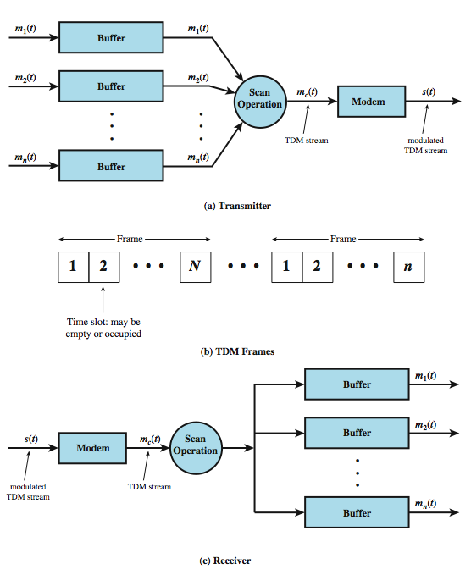
TDM System
Overview
Notes:
A generic depiction of a synchronous TDM system is provided in Stallings DCC8e Figure 8.6. A number of signals [m_{i}(t), i = 1, n] are to be multiplexed onto the same transmission medium. The signals carry digital data and are generally digital signals. The incoming data from each source are briefly buffered. Each buffer is typically one bit or one character in length. The buffers are scanned sequentially to form a composite digital data stream m_{c}(t). The scan operation is sufficiently rapid so that each buffer is emptied before more data can arrive. Thus, the data rate of m_{c}(t) must at least equal the sum of the data rates of the m_{i}(t). The digital signal m_{c}(t) may be transmitted directly, or passed through a modem so that an analog signal is transmitted. In either case, transmission is typically synchronous.
The transmitted data may have a format something like Figure 8.6b. The data are organized into frames. Each frame contains a cycle of time slots. In each frame, one or more slots are dedicated to each data source. The sequence of slots dedicated to one source, from frame to frame, is called a channel. The slot length equals the transmitter buffer length, typically a bit or a byte (character).
At the receiver, the interleaved data are demultiplexed and routed to the appropriate destination buffer. For each input source m_{i}(t), there is an identical output destination that will receive the output data at the same rate at which it was generated.

Slide 49
TDM Link Control
no headers and trailers
data link control protocols not needed
flow control
  data rate of multiplexed line is fixed
  if one channel receiver can not receive data, the others must carry on
  corresponding source must be quenched
  leaving empty slots
error control
  errors detected & handled on individual channel
Notes:
Note that the transmitted data stream depicted in Stallings DCC8e Figure 8.6b does not contain the headers and trailers that we have come to associate with synchronous transmission, as the control mechanisms provided by a data link protocol are not needed. It should be clear that, as far as the multiplexer and demultiplexer (Figure 8.1) are concerned, flow control is not needed. The data rate on the multiplexed line is fixed, and the multiplexer and demultiplexer are designed to operate at that rate. If one of the individual output lines attaches to a device that is temporarily unable to accept data, transmission must continue, since the remaining output lines are expecting to receive data at predetermined times. Thus, the channel in question will carry empty slots, but the frames as a whole will maintain the same transmission rate.
The reasoning for error control is the same. It would not do to request retransmission of an entire TDM frame because an error occurs on one channel. The devices using the other channels do not want a retransmission nor would they know that a retransmission has been requested by some other device on another channel. Again, the solution is to apply error control on a per-channel basis.

Slide 50
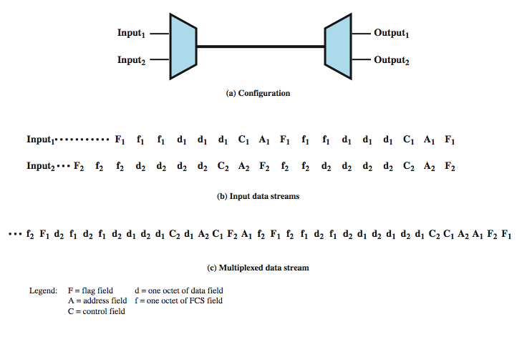
Data Link Control on TDM
Notes:
Flow control and error control can be provided on a per-channel basis by using a data link control protocol such as HDLC on a per-channel basis. A simplified example is shown in Stallings DCC8e Figure 8.7. Assume two data sources, each using HDLC. One is transmitting a stream of HDLC frames containing three octets of data each, and the other is transmitting HDLC frames containing four octets of data. For clarity, we assume that character-interleaved multiplexing is used, although bit interleaving is more typical. The octets of the HDLC frames from the two sources are shuffled together for transmission over the multiplexed line. Note that even though the HDLC frames have lost their integrity in some sense, the pieces are reassembled correctly before they are seen by the device on the other end of the HDLC protocol. In this sense, the multiplexing/demultiplexing operation is transparent to the attached stations; to each communicating pair of stations, it appears that they have a dedicated link.
One refinement is needed in this figure. Both ends of the line need to be a combination multiplexer/demultiplexer with a full-duplex line in between. Then each channel consists of two sets of slots, one traveling in each direction. The individual devices attached at each end can, in pairs, use HDLC to control their own channel. The multiplexer/demultiplexers need not be concerned with these matters.

Slide 51
Framing
no flag or SYNC chars bracketing TDM frames
must still provide synchronizing mechanism between src and dest clocks
added digit framing
  one control bit added to each TDM frame
  identifiable bit pattern used on control channel
  eg. alternating 01010101…unlikely on a data channel
  compare incoming bit patterns on each channel with known sync pattern
Notes:
See that a link control protocol is not needed to manage the overall TDM link. There is, however, a basic requirement for framing. Because we are not providing flag or SYNC characters to bracket TDM frames, some means is needed to assure frame synchronization. It is clearly important to maintain framing synchronization because, if the source and destination are out of step, data on all channels are lost.
Perhaps the most common mechanism for framing is known as added-digit framing. In this scheme, typically, one control bit is added to each TDM frame. An identifiable pattern of bits, from frame to frame, is used as a "control channel." A typical example is the alternating bit pattern, 101010…. This is a pattern unlikely to be sustained on a data channel. Thus, to synchronize, a receiver compares the incoming bits of one frame position to the expected pattern. If the pattern does not match, successive bit positions are searched until the pattern persists over multiple frames. Once framing synchronization is established, the receiver continues to monitor the framing bit channel. If the pattern breaks down, the receiver must again enter a framing search mode.

Slide 52
Pulse Stuffing
have problem of synchronizing data sources
with clocks in different sources drifting
also issue of data rates from different sources not related by simple rational number
Pulse Stuffing a common solution
  have outgoing data rate (excluding framing bits) higher than sum of incoming rates
  stuff extra dummy bits or pulses into each incoming signal until it matches local clock
  stuffed pulses inserted at fixed locations in frame and removed at demultiplexer
Notes:
Perhaps the most difficult problem in the design of a synchronous time division multiplexer is that of synchronizing the various data sources. If each source has a separate clock, any variation among clocks could cause loss of synchronization. Also, in some cases, the data rates of the input data streams are not related by a simple rational number. For both these problems, a technique known as pulse stuffing is an effective remedy. With pulse stuffing, the outgoing data rate of the multiplexer, excluding framing bits, is higher than the sum of the maximum instantaneous incoming rates. The extra capacity is used by stuffing extra dummy bits or pulses into each incoming signal until its rate is raised to that of a locally generated clock signal. The stuffed pulses are inserted at fixed locations in the multiplexer frame format so that they may be identified and removed at the demultiplexer.

Slide 53
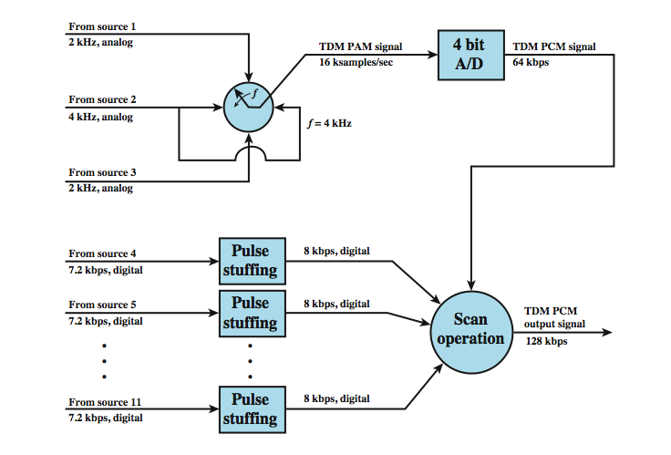
TDM Example
Notes:
Example 8.3 illustrates the use of synchronous TDM to multiplex digital and analog sources (Figure 8.8). Consider that there are 11 sources to be multiplexed on a single link: Source 1: Analog, 2-kHz bandwidth, Source 2: Analog, 4-kHz bandwidth, Source 3: Analog, 2-kHz bandwidth, Sources 4-11: Digital, 7200 bps synchronous
As a first step, the analog sources are converted to digital using PCM. Recall from Chapter 5 that PCM is based on the sampling theorem, which dictates that a signal be sampled at a rate equal to twice its bandwidth. Thus, the required sampling rate is 4000 samples per second for sources 1 and 3, and 8000 samples per second for source 2. These samples, which are analog (PAM), must then be quantized or digitized. Let us assume that 4 bits are used for each analog sample. For convenience, these three sources will be multiplexed first, as a unit. At a scan rate of 4 kHz, one PAM sample each is taken from sources 1 and 3, and two PAM samples are taken from source 2 per scan. These four samples are interleaved and converted to 4-bit PCM samples. Thus, a total of 16 bits is generated at a rate of 4000 times per second, for a composite bit rate of 64 kbps. For the digital sources, pulse stuffing is used to raise each source to a rate of 8 kbps, for an aggregate data rate of 64 kbps. A frame can consist of multiple cycles of 32 bits, each containing 16 PCM bits and two bits from each of the eight digital sources.

Slide 54
Digital Carrier Systems
long-distance links use an TDM hierarchy
AT&T (USA) and ITU-T (International) variants
US system based on DS-1 format
can carry mixed voice and data signals
24 channels used for total data rate 1.544Mbps
each voice channel contains one word of digitized data (PCM, 8000 samples per sec)
same format for 56kbps digital data
can interleave DS-1 channels for higher rates
  DS-2 is four DS-1 at 6.312Mbps
Notes:
The long-distance carrier system provided in the United States and throughout the world was designed to transmit voice signals over high-capacity transmission links, such as optical fiber, coaxial cable, and microwave. Part of the evolution of these telecommunications networks to digital technology has been the adoption of synchronous TDM transmission structures. In the United States, AT&T developed a hierarchy of TDM structures of various capacities; this structure is used in Canada and Japan as well as the United States. A similar, but unfortunately not identical, hierarchy has been adopted internationally under the auspices of ITU-T.
The basis of the TDM hierarchy (in North America and Japan) is the DS-1 transmission format. The same DS-1 format is used to provide both multiplexed voice and digital data services. Above the DS-1 data rate of 1.544 Mbps, higher-level multiplexing is achieved by interleaving bits from DS-1 inputs. For example, the DS-2 transmission system combines four DS-1 inputs into a 6.312-Mbps stream. Data from the four sources are interleaved 12 bits at a time. Note that 1.544 × 4 = 6.176 Mbps. The remaining capacity is used for framing and control bits.

Slide 55
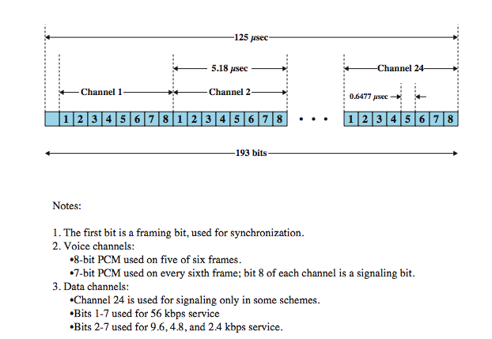
DS-1 Transmission Format
Notes:
The basis of the TDM hierarchy (in North America and Japan) is the DS-1 transmission format (shown above from Stallings DCC8e Figure 8.9), which multiplexes 24 channels. Each frame contains 8 bits per channel plus a framing bit for 24 × 8 + 1 = 193 bits. For voice transmission, each channel contains one word of digitized voice data. The original analog voice signal is digitized using pulse code modulation (PCM) at a rate of 8000 samples per second. With a frame length of 193 bits, we have a data rate of 8000 × 193 = 1.544 Mbps. For five of every six frames, 8-bit PCM samples are used. For every sixth frame, each channel contains a 7-bit PCM word plus a signaling bit. The signaling bits form a stream for each voice channel that contains network control and routing information. For example, control signals are used to establish a connection or terminate a call.
The same DS-1 format is used to provide digital data service. For compatibility with voice, the same 1.544-Mbps data rate is used. In this case, 23 channels of data are provided. The twenty-fourth channel position is reserved for a special sync byte, which allows faster and more reliable reframing following a framing error. Within each channel, 7 bits per frame are used for data, with the eighth bit used to indicate whether the channel, for that frame, contains user data or system control data. With 7 bits per channel and 8000 frames per second, a data rate of 56 kbps can be provided per channel. Lower data rates are provided using a technique known as subrate multiplexing, where an additional bit is robbed from each channel to indicate which subrate multiplexing rate is being provided. This leaves a total capacity per channel of 6 × 8000 = 48 kbps. This capacity is used to multiplex five 9.6-kbps channels, ten 4.8-kbps channels, or twenty 2.4-kbps channels.

Slide 56
SONET/SDH
Synchronous Optical Network (ANSI)
Synchronous Digital Hierarchy (ITU-T)
have hierarchy of signal rates
  Synchronous Transport Signal level 1 (STS-1) or Optical Carrier level 1 (OC-1) is 51.84Mbps
  carries one DS-3 or multiple (DS1 DS1C DS2) plus ITU-T rates (eg. 2.048Mbps)
  multiple STS-1 combine into STS-N signal
  ITU-T lowest rate is 155.52Mbps (STM-1)
Notes:
SONET (Synchronous Optical Network) is an optical transmission interface originally proposed by BellCore and standardized by ANSI. A compatible version, referred to as Synchronous Digital Hierarchy (SDH), has been published by ITU-T in Recommendation G.707. SONET is intended to provide a specification for taking advantage of the high-speed digital transmission capability of optical fiber. The SONET specification defines a hierarchy of standardized digital data rates (see Stallings DCC8e Table 8.4). The lowest level, referred to as STS-1 (Synchronous Transport Signal level 1) or OC-1 (Optical Carrier level 1), is 51.84 Mbps. This rate can be used to carry a single DS-3 signal or a group of lower-rate signals, such as DS1, DS1C, DS2, plus ITU-T rates (e.g., 2.048 Mbps). An OC-N rate is the optical equivalent of an STS-N electrical signal. End user devices transmit and receive electrical signals; these must be converted to and from optical signals for transmission over optical fiber. Multiple STS-1 signals can be combined to form an STS-N signal. The signal is created by interleaving bytes from N STS-1 signals that are mutually synchronized. For the ITU-T Synchronous Digital Hierarchy, the lowest rate is 155.52 Mbps, which is designated STM-1. This corresponds to SONET STS-3.

Slide 57
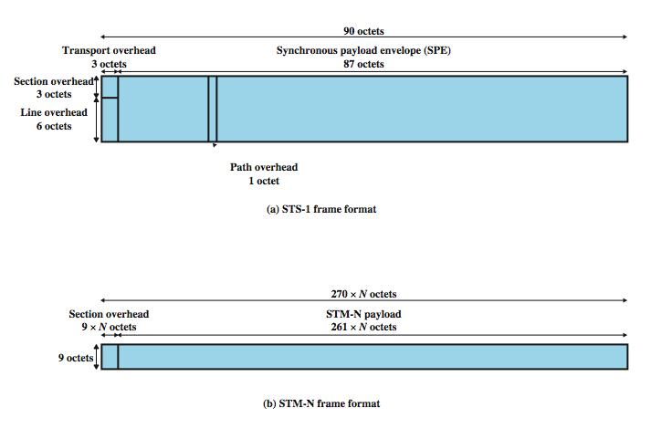
SONET Frame Format
Notes:
The basic SONET building block is the STS-1 frame, which consists of 810 octets and is transmitted once every 125 µs, for an overall data rate of 51.84 Mbps (see Stallings DCC8e Figure 8.10a). The frame can logically be viewed as a matrix of 9 rows of 90 octets each, with transmission being one row at a time, from left to right and top to bottom. The first three columns (3 octets × 9 rows = 27 octets) of the frame are devoted to overhead octets. Nine octets are devoted to section-related overhead and 18 octets are devoted to line overhead. Figure 8.11a shows the arrangement of overhead octets, and Stallings DCC8e Table 8.5 defines the various fields. The remainder of the frame is payload. The payload includes a column of path overhead, which is not necessarily in the first available column position; the line overhead contains a pointer that indicates where the path overhead starts. Figure 8.11b shows the arrangement of path overhead octets, and Table 8.5 defines these. Stallings DCC8e Figure 8.10b shows the general format for higher-rate frames, using the ITU-T designation.

Slide 58
Statistical TDM
in Synch TDM many slots are wasted
Statistical TDM allocates time slots dynamically based on demand
multiplexer scans input lines and collects data until frame full
line data rate lower than aggregate input line rates
may have problems during peak periods
  must buffer inputs
Notes:
In a synchronous time division multiplexer, many of the time slots in a frame are often wasted. Statistical time division multiplexing provides a generally more efficient service than synchronous TDM for the support of terminals. With statistical TDM, time slots are not preassigned to particular data sources. Rather, user data are buffered and transmitted as rapidly as possible using available time slots. As with a synchronous TDM, the statistical multiplexer has a number of I/O lines on one side and a higher speed multiplexed line on the other. Each I/O line has a buffer associated with it. In the case of the statistical multiplexer, there are n I/O lines, but only k, where k < n, time slots available on the TDM frame. For input, the function of the multiplexer is to scan the input buffers, collecting data until a frame is filled, and then send the frame. On output, the multiplexer receives a frame and distributes the slots of data to the appropriate output buffers. Because statistical TDM takes advantage of the fact that the attached devices are not all transmitting all of the time, the data rate on the multiplexed line is less than the sum of the data rates of the attached devices. Thus, a statistical multiplexer can use a lower data rate to support as many devices as a synchronous multiplexer. However there is more overhead per slot for statistical TDM because each slot carries an address as well as data. The difficulty with this approach is that, while the average aggregate input may be less than the multiplexed line capacity, there may be peak periods when the input exceeds capacity. The solution to this problem is to include a buffer in the multiplexer to hold temporary excess input. There is a tradeoff between the size of the buffer used and the data rate of the line. We would like to use the smallest possible buffer and the smallest possible data rate, but a reduction in one requires an increase in the other.

Slide 59
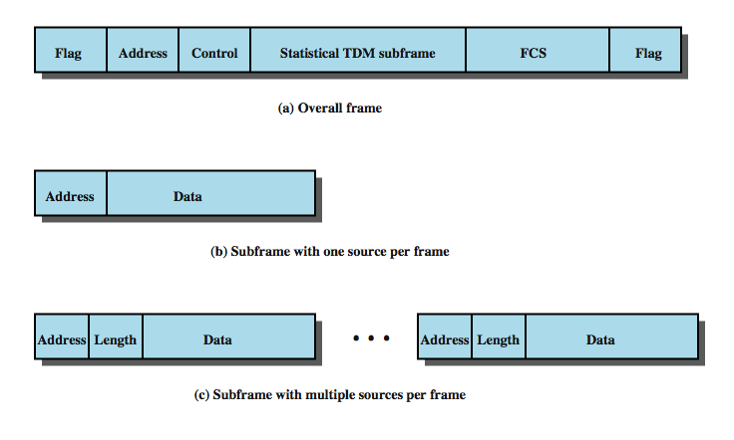
Statistical TDM Frame Format
Notes:
The frame structure used by a statistical multiplexer has an impact on performance. Clearly, it is desirable to minimize overhead bits to improve throughput. Stallings DCC8e Figure 8.13 shows two possible formats. In the first case, only one source of data is included per frame. That source is identified by an address. The length of the data field is variable, and its end is marked by the end of the overall frame. This scheme can work well under light load but is quite inefficient under heavy load. A way to improve efficiency is to allow multiple data sources to be packaged in a single frame. Now, however, some means is needed to specify the length of data for each source. Thus, the statistical TDM subframe consists of a sequence of data fields, each labeled with an address and a length. Several techniques can be used to make this approach even more efficient. The address field can be reduced by using relative addressing, which specifies the number of the current source relative to the previous source, modulo the total number of sources. Another refinement is to use a 2-bit label with the length field. A value of 00, 01, or 10 corresponds to a data field of 1, 2, or 3 bytes; no length field is necessary. A value of 11 indicates that a length field is included. Yet another approach is to multiplex one character from each data source that has a character to send in a single data frame. In this case the frame begins with a bit map that has a bit length equal to the number of sources. For each source that transmits a character during a given frame, the corresponding bit is set to one.

Slide 60
Cable Modems
dedicate two cable TV channels to data transfer
each channel shared by number of subscribers, using statistical TDM
Downstream
  cable scheduler delivers data in small packets
  active subscribers share downstream capacity
  also allocates upstream time slots to subscribers
Upstream
  user requests timeslots on shared upstream channel
  Headend scheduler notifies subscriber of slots to use
Notes:
To support data transfer to and from a cable modem, a cable TV provider dedicates two channels, one for transmission in each direction. Each channel is shared by a number of subscribers, and so some scheme is needed for allocating capacity on each channel for transmission. Typically, a form of statistical TDM is used. In the downstream direction, cable headend to subscriber, a cable scheduler delivers data in the form of small packets. Because the channel is shared by a number of subscribers, if more than one subscriber is active, each subscriber gets only a fraction of the downstream capacity. An individual cable modem subscriber may experience access speeds from 500 kbps to 1.5 Mbps or more, depending on the network architecture and traffic load. The downstream direction is also used to grant time slots to subscribers. When a subscriber has data to transmit, it must first request time slots on the shared upstream channel. Each subscriber is given dedicated time slots for this request purpose. The headend scheduler responds to a request packet by sending back an assignment of future time slots to be used by this subscriber. Thus, a number of subscribers can share the same upstream channel without conflict

Slide 61
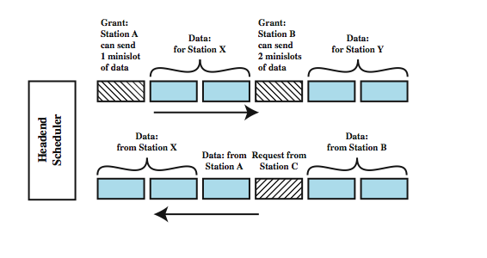
Cable Modem Scheme
Notes:
A form of statistical TDM is typically used with Cable Modems, as illustrated in Stallings DCC8e Figure 8.16. This also shows the request and allocation of upstream time slots.

Slide 62
Asymmetrical Digital Subscriber Line (ADSL)
link between subscriber and network
uses currently installed twisted pair cable
is Asymmetric - bigger downstream than up
uses Frequency division multiplexing
  reserve lowest 25kHz for voice (POTS)
  uses echo cancellation or FDM to give two bands
has a range of up to 5.5km
Notes:
In the implementation and deployment of a high-speed wide area public digital network, the most challenging part is the link between subscriber and network: the digital subscriber line. ADSL is the most widely publicized of a family of new modem technologies designed to provide high-speed digital data transmission over ordinary telephone wire. The term asymmetric refers to the fact that ADSL provides more capacity downstream (from the carrier’s central office to the customer’s site) than upstream (from customer to carrier), being a good fit to Internet requirements. ADSL uses frequency division multiplexing (FDM) in a novel way to exploit the 1-MHz capacity of twisted pair. When echo cancellation is used, the entire frequency band for the upstream channel overlaps the lower portion of the downstream channel. The ADSL scheme provides a range of up to 5.5 km, depending on the diameter of the cable and its quality.

Slide 63
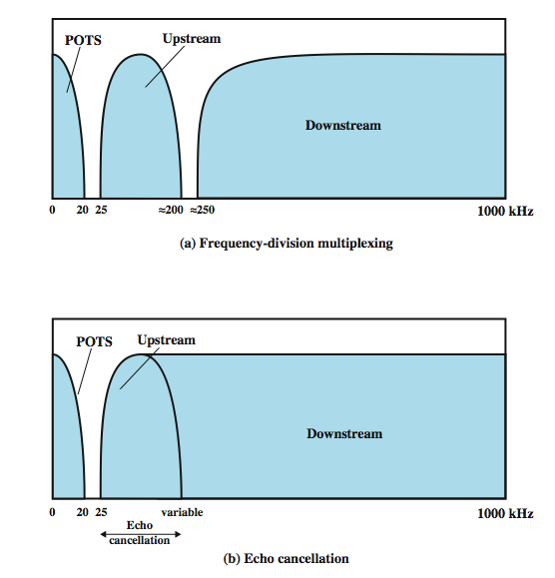
ADSL Channel Configuration
Notes:
ADSL uses frequency division multiplexing (FDM). There are three elements of the ADSL strategy, shown above in Stallings DCC8e Figure 8.17:
• Reserve lowest 25 kHz for voice (POTS - plain old telephone service). The voice is carried only in the 0 to 4 kHz band; the additional bandwidth is to prevent crosstalk between the voice and data channels.
• Use either echo cancellation or FDM to allocate two bands, a smaller upstream band and a larger downstream band. Echo cancellation is a signal processing technique that allows transmission of digital signals in both directions on a single transmission line simultaneously. In essence, a transmitter must subtract the echo of its own transmission from the incoming signal to recover the signal sent by the other side.
• Use FDM within the upstream and downstream bands. In this case, a single bit stream is split into multiple parallel bit streams and each portion is carried in a separate frequency band.
When echo cancellation is used, the entire frequency band for the upstream channel overlaps the lower portion of the downstream channel. This has two advantages compared to the use of distinct frequency bands for upstream and downstream: the higher the frequency, the greater the attenuation., and echo cancellation design is more flexible for changing upstream capacity. The disadvantage of the use of echo cancellation is the need for echo cancellation logic on both ends of the line.

Slide 64
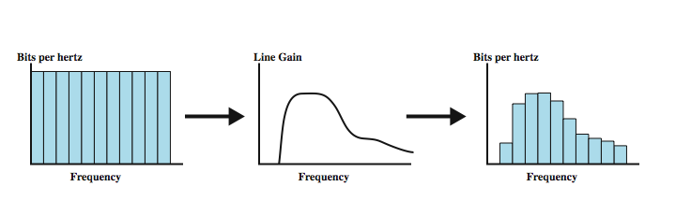
Discrete Multitone (DMT)
multiple carrier signals at different frequencies
divide into 4kHz subchannels
test and use subchannels with better SNR
256 downstream subchannels at 4kHz (60kbps)
  in theory 15.36Mbps, in practice 1.5-9Mbps
Notes:
Discrete multitone (DMT) uses multiple carrier signals at different frequencies, sending some of the bits on each channel. The available transmission band (upstream or downstream) is divided into a number of 4-kHz subchannels. On initialization, the DMT modem sends out test signals on each subchannel to determine the signal-to-noise ratio (SNR). The modem then assigns more bits to channels with better signal transmission qualities and less bits to channels with poorer signal transmission qualities. Stallings DCC8e Figure 8.18 illustrates this process. Each subchannel can carry a data rate of from 0 to 60 kbps. The figure shows a typical situation in which there is increasing attenuation and hence decreasing signal-to-noise ratio at higher frequencies. As a result, the higher-frequency subchannels carry less of the load. Present ADSL/DMT designs employ 256 downstream subchannels. In theory, with each 4-kHz subchannel carrying 60 kbps, it would be possible to transmit at a rate of 15.36 Mbps. In practice, transmission impairments prevent attainment of this data rate. Current implementations operate at from 1.5 to 9 Mbps, depending on line distance and quality.

Slide 65
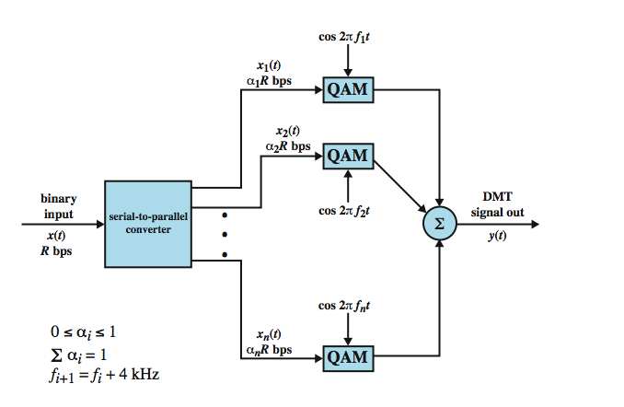
DMT Transmitter
Notes:
Stallings DCC8e Figure 8.19 provides a general block diagram for DMT transmission. After initialization, the bit stream to be transmitted is divided into a number of substreams, one for each subchannel that will carry data. The sum of the data rates of the substreams is equal to the total data rate. Each substream is then converted to an analog signal using quadrature amplitude modulation (QAM), described in Chapter 5. This scheme works easily because of QAM’s ability to assign different numbers of bits per transmitted signal. Each QAM signal occupies a distinct frequency band, so these signals can be combined by simple addition to produce the composite signal for transmission.

Slide 66
xDSL
High data rate DSL (HDSL)
  2B1Q coding on dual twisted pairs
  up to 2Mbps over 3.7km
Single line DSL
  2B1Q coding on single twisted pair (residential) with echo cancelling
  up to 2Mbps over 3.7km
Very high data rate DSL
  DMT/QAM for very high data rates
  over separate bands for separate services
Notes:
ADSL is one of a number of recent schemes for providing high-speed digital transmission of the subscriber line, which collectively are referred to as xDSL.
High Data Rate Digital Subscriber Line (HDSL) was developed in the late 1980s by BellCore as a T1 replacement. HDSL uses the 2B1Q coding scheme to provide a data rate of up to 2 Mbps over two twisted-pair lines within a bandwidth that extends only up to about 196 kHz. This enables a range of about 3.7 km to be achieved.
Single Line Digital Subscriber Line (SDSL) was developed to provide the same type of service as HDSL but over a single twisted-pair line for residential subscribers. As with HDSL, 2B1Q coding is used. Echo cancellation is used to achieve full-duplex transmission over a single pair.
Very High Data Rate Digital Subscriber Line (VDSL) is one of the newest xDSL schemes. The objective is to provide a scheme similar to ADSL at a much higher data rate by sacrificing distance. The likely signaling technique is DMT/QAM. VDSL does not use echo cancellation but provides separate bands for different services, with the following tentative allocation: POTS: 0 – 4 kHz, ISDN: 4 – 80 kHz, Upstream: 300 – 700 kHz, Downstream: ≥ 1 MHz.

Slide 67
Summary
looked at multiplexing multiple channels on a single link
FDM
TDM
Statistical TDM
ADSL and xDSL
Notes:
Chapter 8 summary.

